Slide 1

BOOTES-4 robotic astronomical observatory, linking time domain astronomy and data intensive astronomy
Chenzhou Cui(1), Alberto Castro-Tirado (2), Sergey. Guziy (3), Petr Kubánek(2,5), Yufeng Fan(4), Jiming Bai(4), Chuanjun Wang(4), Yuxin Xin(4), Jian Li(1), Oscar Lara-Gil (2), Ronan Cunniffe (2), Xiaohong Zhao (4), J.C. Tello (2), J. Gorosabel (2), Zihuang Cao(1), Boliang He (1)
1. National Astronomical Observatories, Chinese Academy of Sciences, Beijing 100012, China
2. Instituto de Astrof´ısica de Andaluc´ıa (IAA-CSIC), Glorieta de la Astronom´ıa s/n, 18008 Granada, Spain
3. Kalinenkov Astronomical Observatory, Mykolaiv National University, Nikolska 24, Mykolaiv, 54030, Ukraine.
4. Yunnan National Astronomical Observatory, Chinese Academy of Sciences, Kunming, China
5. IP AS CR

Slide 2
Burst Observer and Optical Transient Exploring System (BOOTES)
The Burst Observer and Optical Transient Exploring System (BOOTES), started in 1998 as a Spanish-Czech collaboration devoted to study optical emissions from gamma ray bursts (GRBs).
The first two BOOTES stations were located in Spain and included medium size robotic telescopes with CCD cameras at the Cassegrain focus as well as all-sky cameras. The first light of the first observing station (BOOTES-1) was obtained in July 1998. The second observing station (BOOTES-2) are fully operating since July 2001.
In 2009 BOOTES expanded abroad, with the third station (BOOTES-3) being installed in Blenheim (South Island, New Zealand).
The fourth one (BOOTES-4) has been deployed in 2011 at the Lijiang Astronomical Observatory (Yunnan, China).

Slide 3
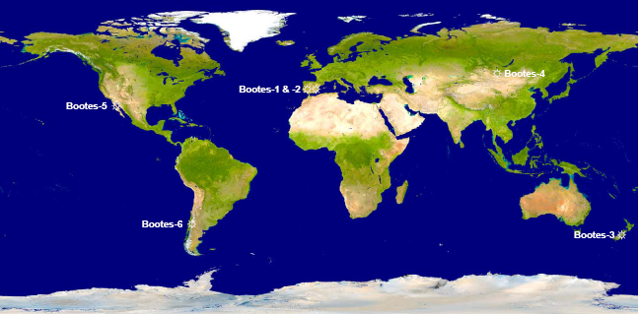
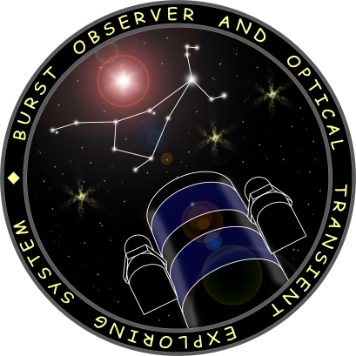

The BOOTES Network Philosophy (I)
Integrated in:
Identical telescopes placed around the Earth
Identical filter sets: g’r’i’ZY
Identical CCD cameras
Impact on several scientific fields and public outreach

Slide 4
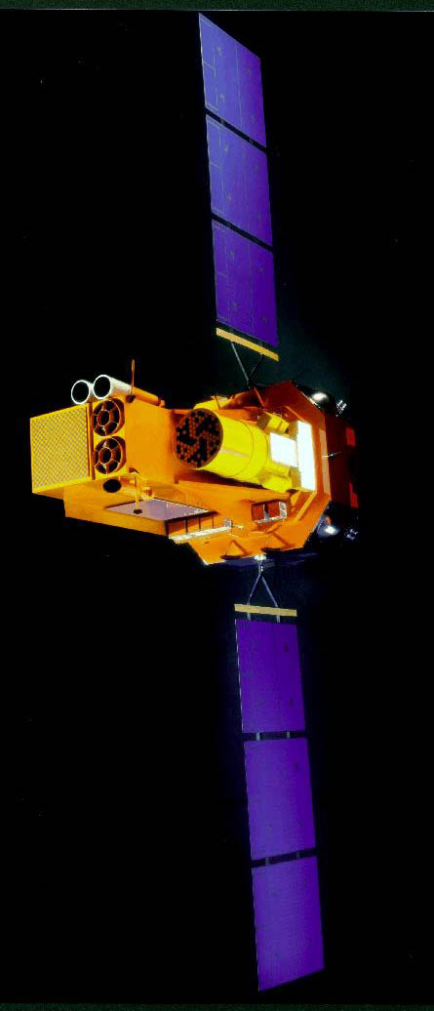
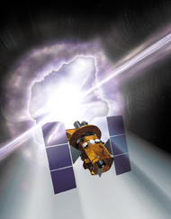
The BOOTES Network Philosophy (II)
Ground-support to space based missions
Very fast slewing speed (> 100 deg/s), easy rescheduling, fast readout (< 1s)
INTEGRAL
SWIFT
UFFO @ Lomonosov
2002- 2004- 2012-

Slide 5
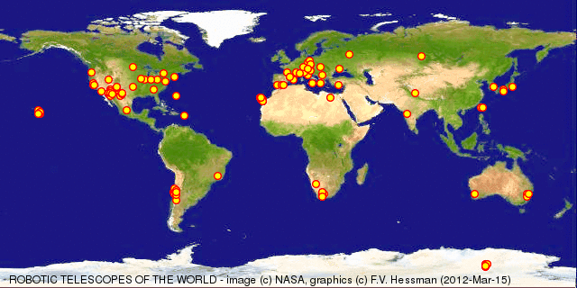

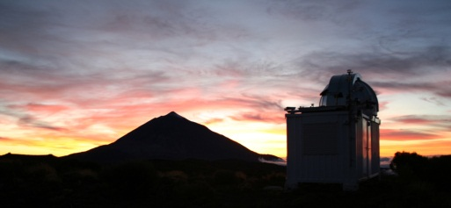
RAO World Map
Robotic Autonomous Observatory: A telescope that performs various remote observations and is able to adapt itself to changes during the task execution without any kind of human assistance (e.g., weather monitoring; the system must not endanger a human!). (Alberto Javier Castro-Tirado, 2010)

Slide 6
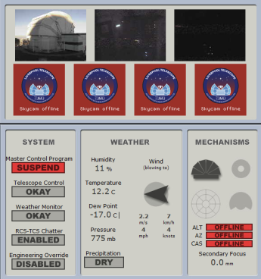
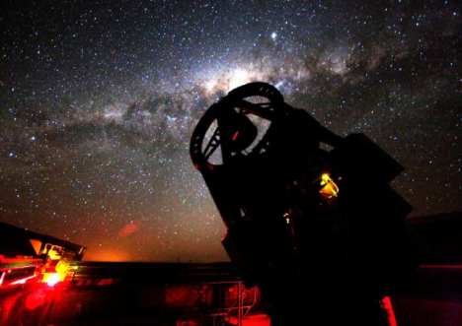
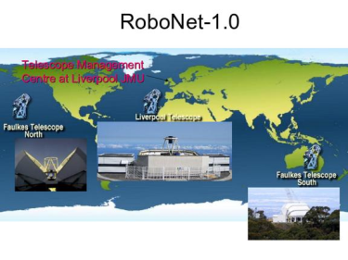

RAO Network projects
MONET (south+north)
Bootes (I, II, III,IV, IR…)
eSTAR
SONG
GONG
LCOGT
  Las Cumbres Observatory Global Telescope
MONET/South

Slide 7
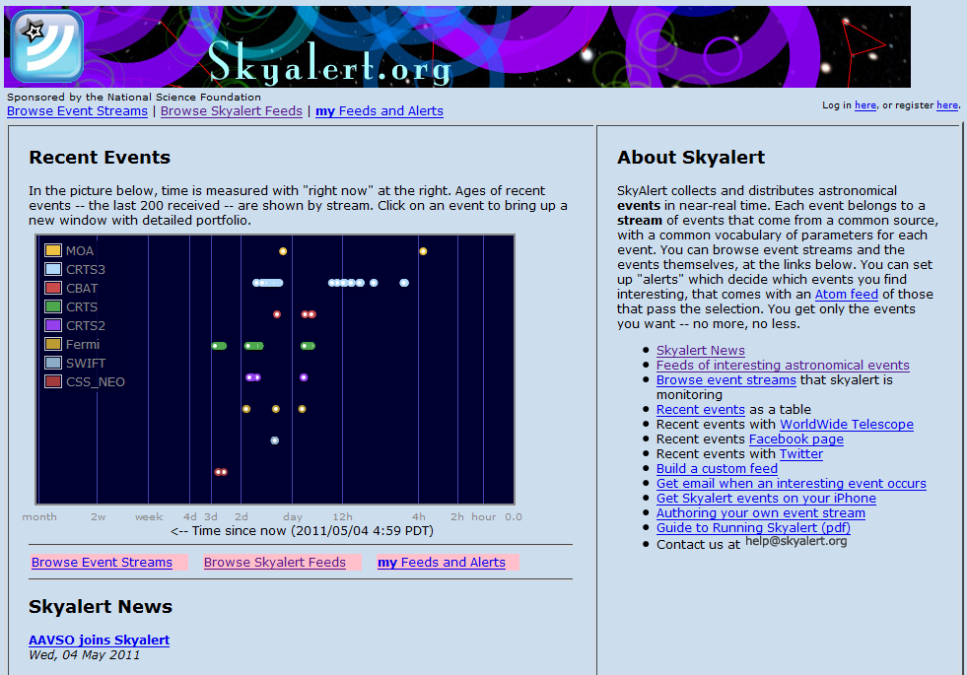
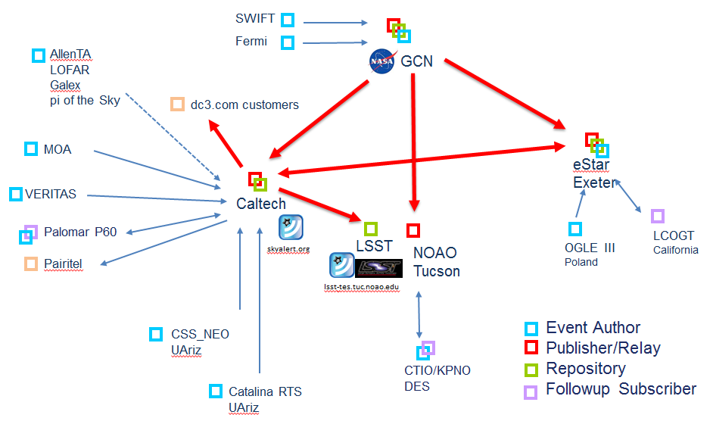
IVOA VOEvent and RAO
VOEvent Charter: The objective of the VOEvent effort is to define the content and meaning of a standard information packet for representing, transmitting, archiving, and publishing a discovery of an immediate event in the sky. We will call this packet VOEvent. The objective is to drive robotic telescopes, to drive archive searches, to alert the community, and to build interoperable archives.

Slide 8

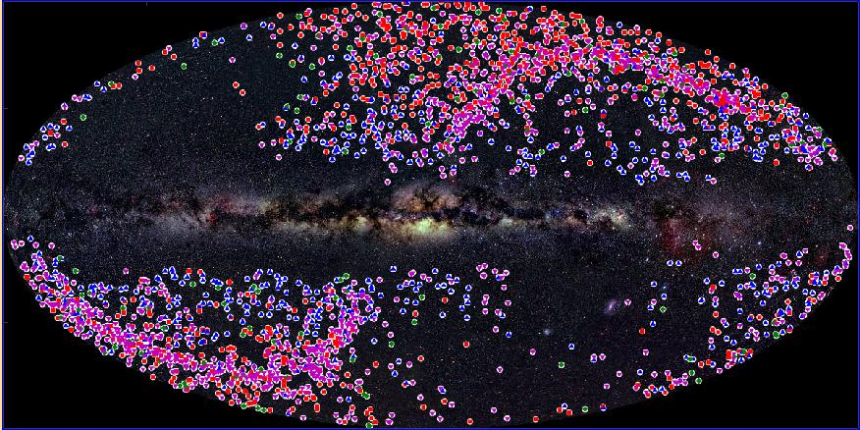
Collaboration with UAz/LPL search for NEA/PHA asteroids; we discover astrophysical transients in their data streams
3 small telescopes , up to 2,500 deg² per night with 4 exposures/pointing, separated by 10 min, limiting mags ~ 19 – 21, several tens of passes per year
Real time processing and event discovery and publication
Open data policy: all data are made public immediately
~ 4,000 unique transients to date, including > 1,000 supernovae (more SNe published in 2009 and 2010 than any other survey), and many other discoveries
Courtesy of Prof. George Djorgovski

Slide 9
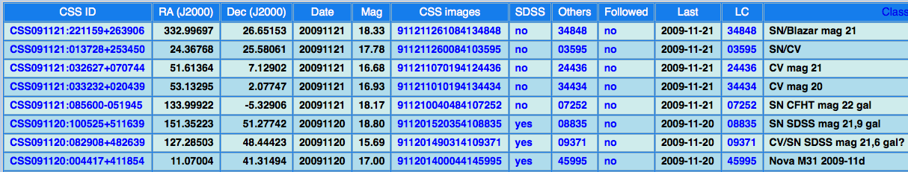
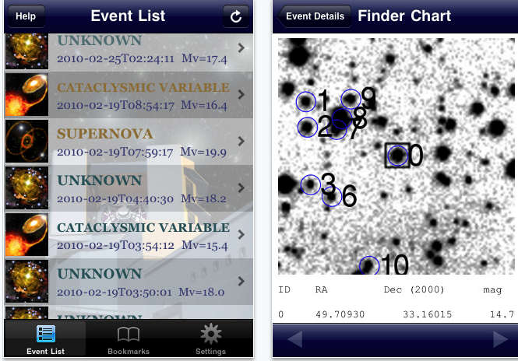
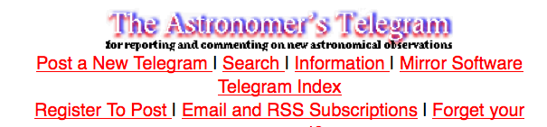
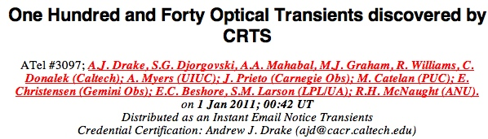

Event Publishing / Dissemination
Real time: VOEvents, Twitter, iApp (thousands of events)
  Also on SkyAlert.org, feeds to the WWT, GoogleSky (outreach)
Next day: annotated tables on the CRTS website
Days/weeks: ATel, CBET for selected transients (~ 200 so far)
Courtesy of Prof. George Djorgovski

Slide 10
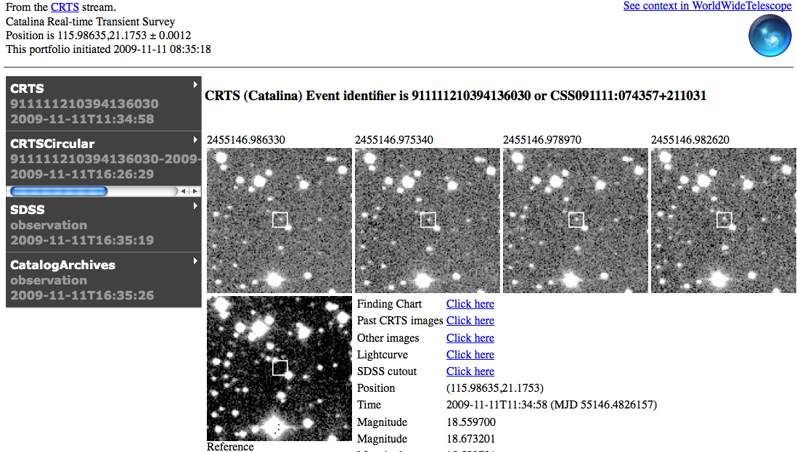
Real Time Event Publishing via VOEvents and SkyAlert
http://skyalert.org
Basic event info
PI: R. Williams
Linked VO/archival data for classif. and follow-up
Subscribe to VOEvents via email, RSS, Atom feed, etc.
Dynamically growing portfolio
Courtesy of Prof. George Djorgovski

Slide 11
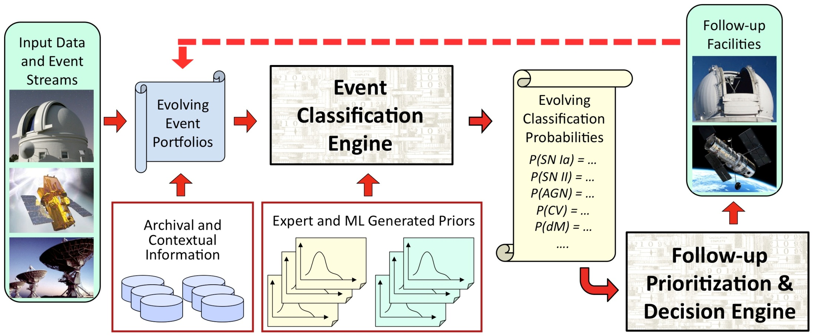
Towards the Automated Event Classification
Incorporation of the contextual information (archival, and from the data themselves) is essential
Automated prioritization of follow-up observations, given the available resources and their cost, and the potential gain
A dynamic, iterative system: improve classif. as new data arrive
Courtesy of Prof. George Djorgovski

Slide 12


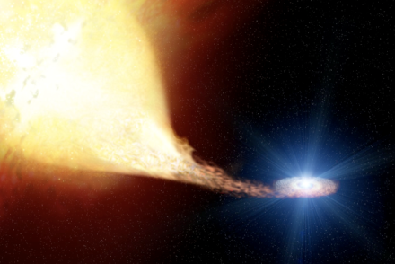

Astronomy in the Time Domain
Driven by the new generation of large digital synoptic sky surveys, leading to LSST, SKA, etc.
  Enabled by the IT revolution; a qulitative change
Rich phenomenology, from the Solar system to cosmology and extreme relativistic physics
  For some phenomena, time domain information is a key to the physical understanding
Static _ Dynamic sky
Sources _ Events
Real-time discovery in massive data streams poses new challenges for knowledge discovery
Synoptic, panoramic surveys  event discovery
Rapid follow-up and multi-λ  keys to understanding
Courtesy of Prof. George Djorgovski

Slide 13
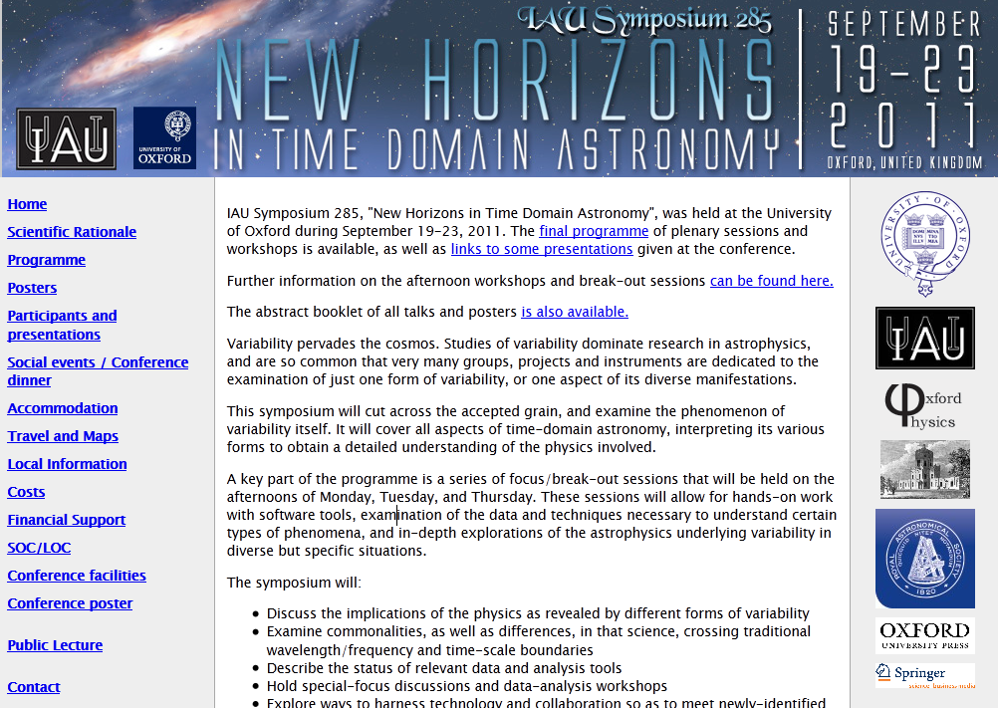

Slide 14
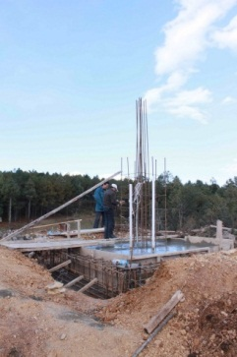
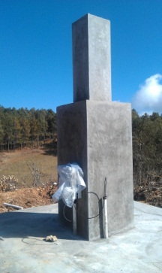
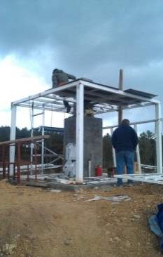
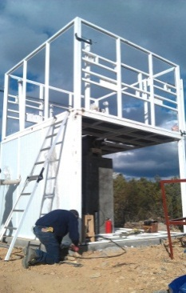
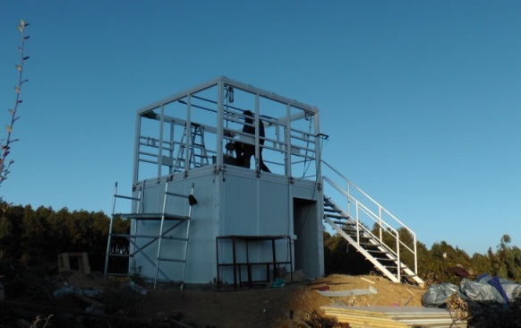
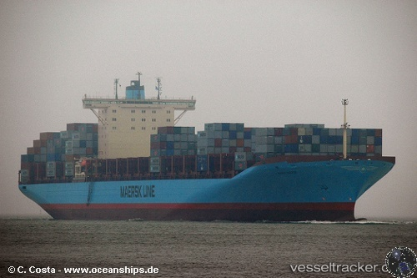
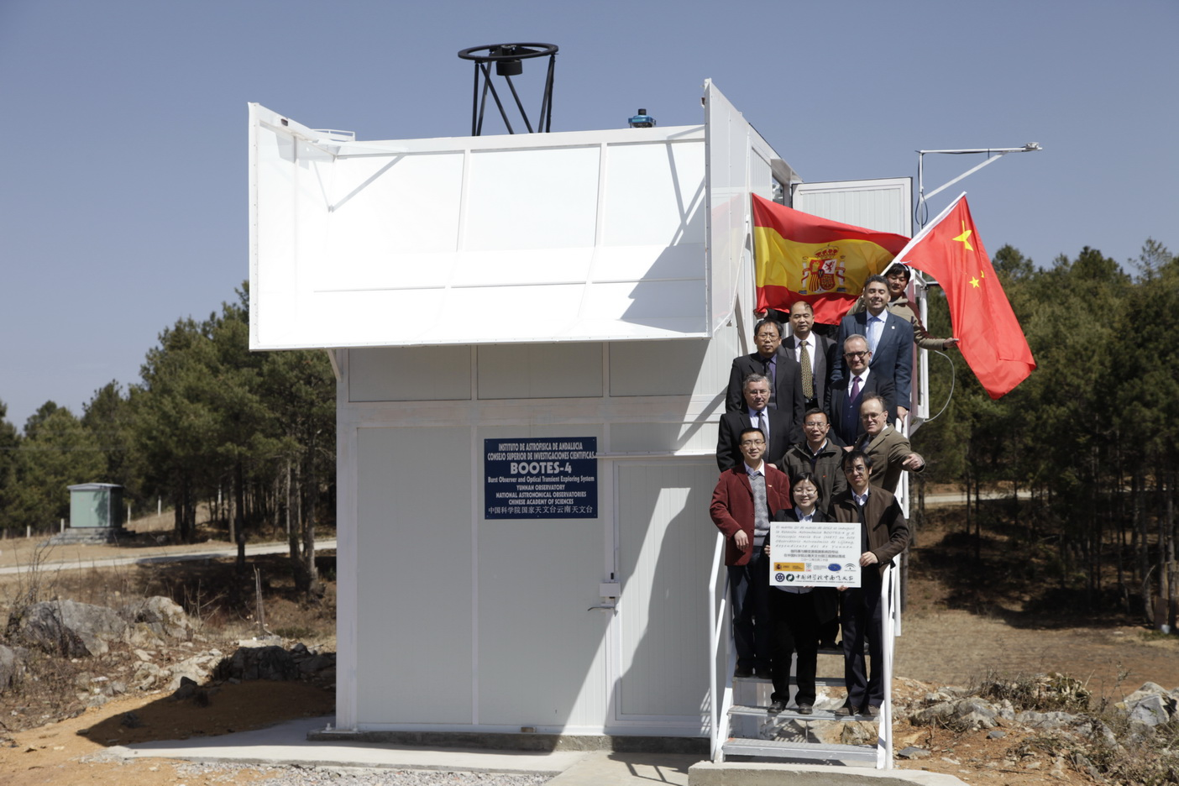
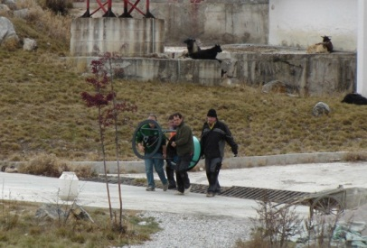
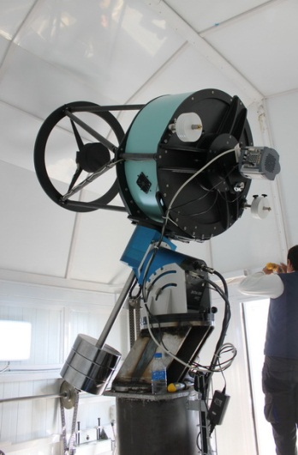
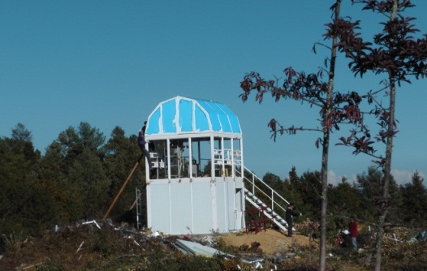
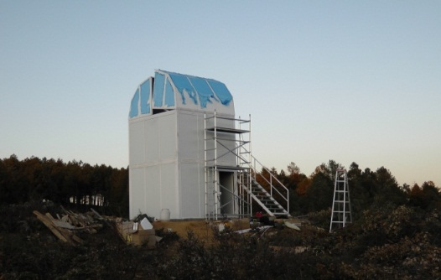
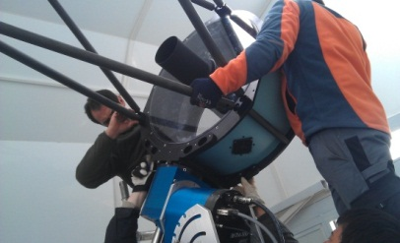
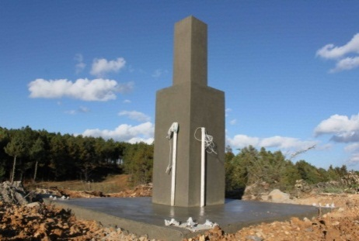
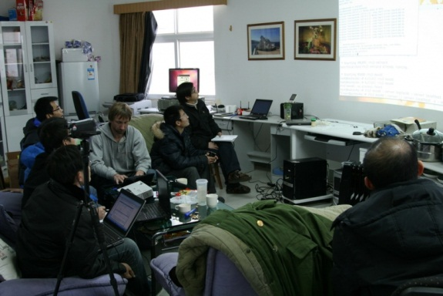
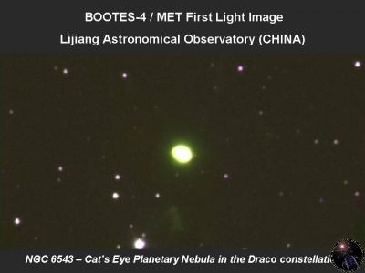
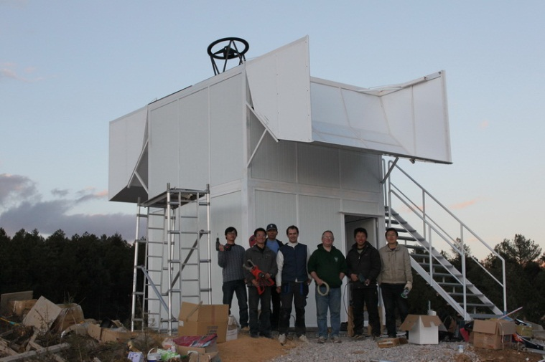
Bootes-4, history review

Slide 15
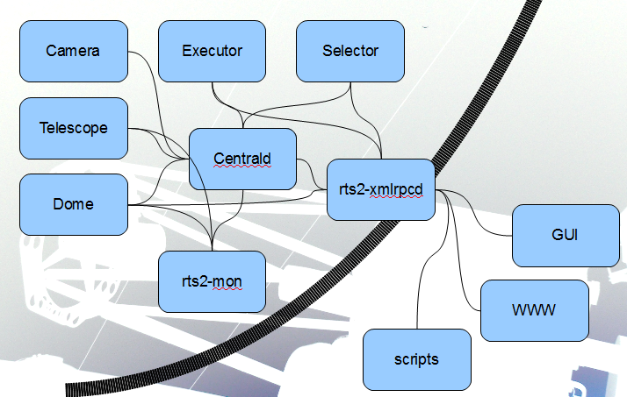
RTS2: Remote Telescope System - 2nd version
Modular
Own TCP/IP protocol
C++/Python
Linux/Unix
Being developed for more than a decade
Open source
BOOTES Spain, New Zealand, China
Czech Republic + Argentina (FRAM)
Watcher (UCD, South Africa)
BORAT (US..), UC NY, ..
RATIR (UNAM + UCB) 1.5m
Danish (-Czech) 1.5m @ La Silla
CAHA 1.23m
MDM LSST CCDs
FLWO 1.2m
Currently > 20 telescopes, 5 continents

Slide 16
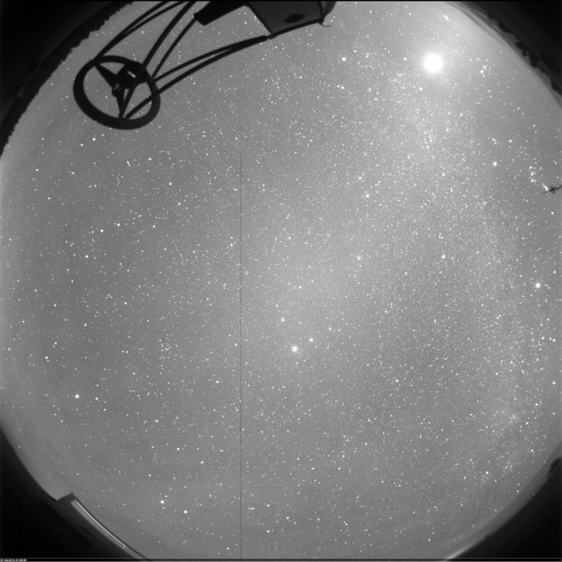
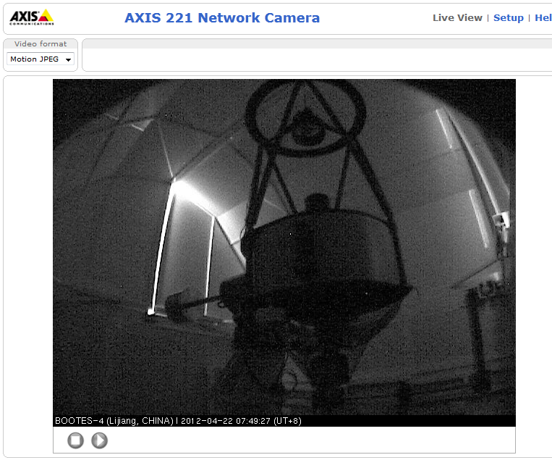
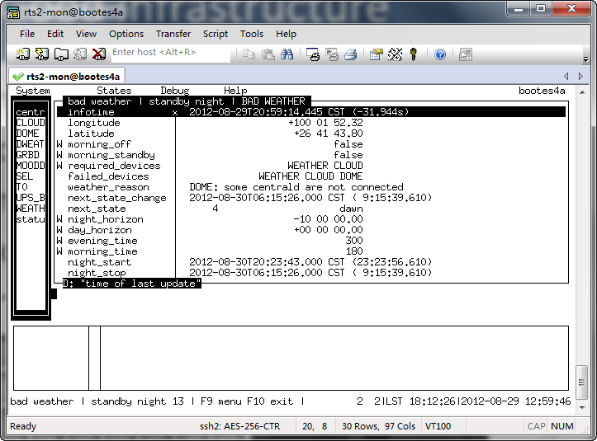
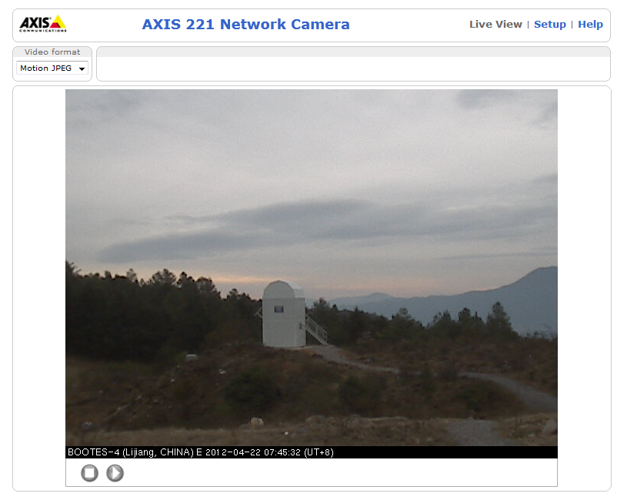
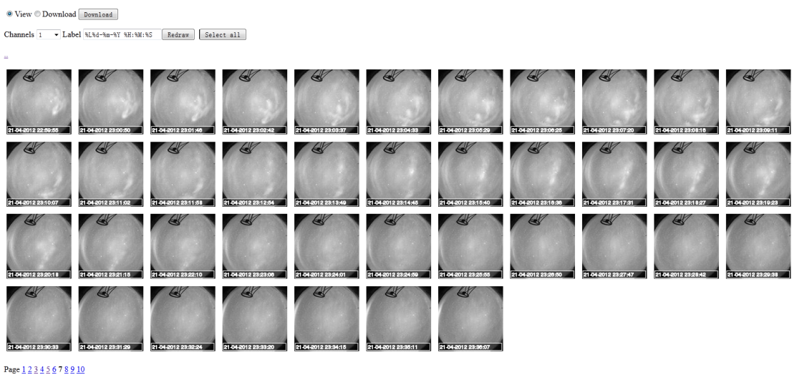
Good Infrastructure
Rich information is available:
Remote control
Autonomous observation
Status monitor
Data access

Slide 17
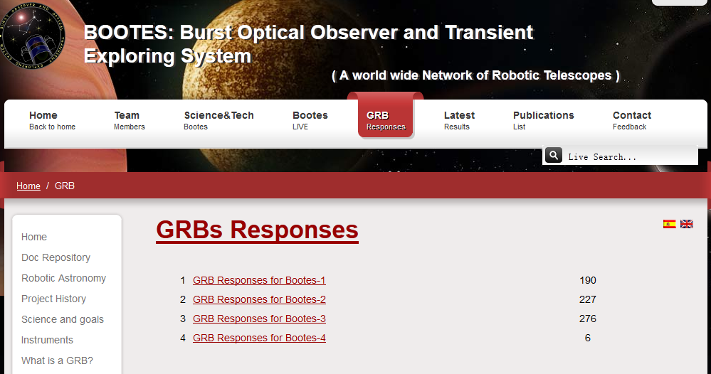
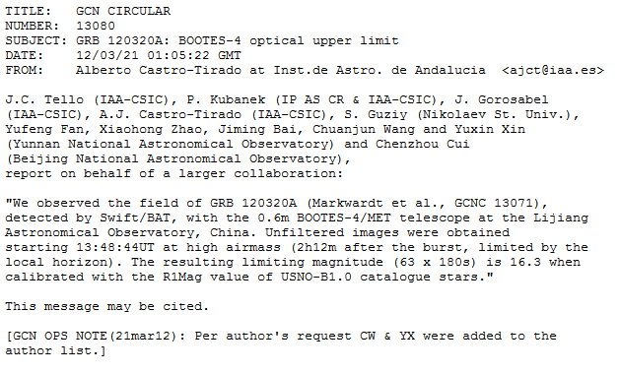
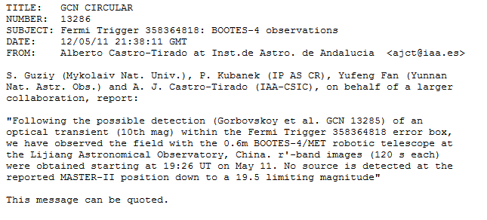
GRBs Responses

Slide 18
China-VO
Virtual Observatory (VO) is a data-intensively online astronomical research and education environment, taking advantages of advanced information technologies to achieve seamless, global access to astronomical information.
VO will play a key role in the era of data intensive astronomy.
Chinese Virtual Observatory (China-VO) is the national VO project in China initiated in 2002 by Chinese astronomical community leading by National Astronomical Observatories, Chinese Academy of Sciences.
China-VO became a member of the IVOA in 2002.
R&D Focuses
China-VO Platform
Unified Access to On-line Astronomical Resources and Services
VO-ready Projects and Facilities
VO-based Astronomical Research Activities
VO-based Public Education

Slide 19
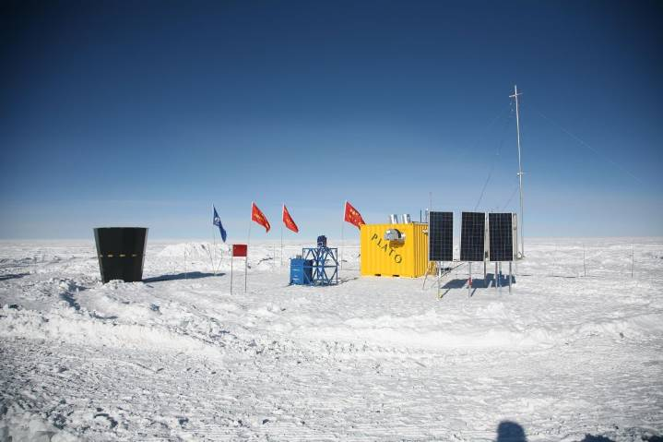
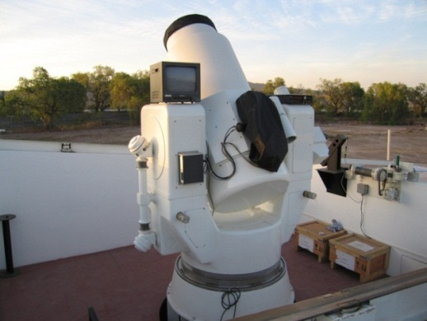
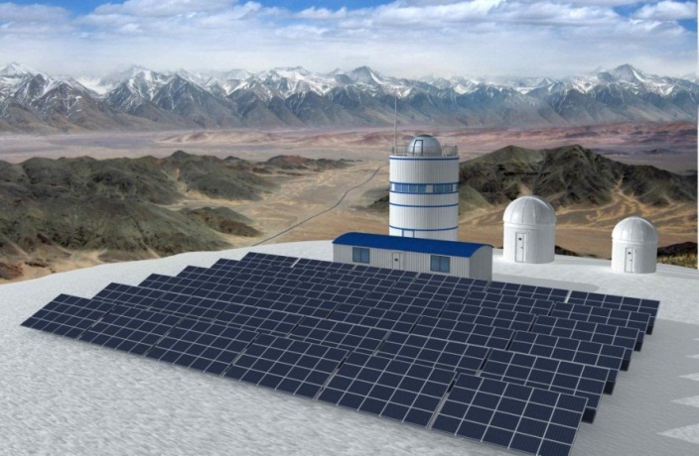
RAO Requirements in China
RAO requirements in China
Bootes-4
LCOGT (Xinjiang)
Antarctic Observatory
Tibet Observatory
Argentina Observatory (San Juan Univ.)
Lunar-based astronomy
International projects: SONG, SVOM, …
School education
Amateur observation
……
CSTAR
Huge Market in China

Slide 20
China-RAON
A project just initiated, no funding support yet.
Not a specific RAO project, but a technical support plan.
A team to provide solutions and technical support to Chinese astronomical community.
  A new service from Chinese Virtual Observatory (China-VO)
Serve professional and non-professional RAO projects used for research and education.
We need RAO solutions
  Software systems (RTS2, Linux/Windows)
  Compliant hardware systems and components
International collaboration

Slide 21
VO-driven Bootes-4
GCN trigged ->VOEvent trigged
Full automatic photometric pipeline
Full automatic archiving
VO-compliant data access
Automated Event Classification

Slide 22
Thank You

